Slide 1
Interpolating Values

Slide 2
Animation
Animator specified
Interpolation
Key frame
Algorithmically controlled
Physics-based
Behavioral
Data-driven
Motion capture

Slide 3
Motivation
Common problem:
Given a set of points, smoothly (in time and space) move an object through the set of points
Example additional temporal constraints:
From zero velocity at first point, smoothly accelerate until time t1, hold a constant velocity until time t2, then smoothly decelerate to a stop at the last point at time t3

Slide 4




Motivation – solution steps
Construct a space curve that interpolates the given points with piecewise first order continuity
Construct an arc-length-parametric-value function for the curve
Construct time-arc-length function according to given constraints
$$p=p(u)$$
$$u=u(s)$$
$$s=s(t)$$
$$p=p(u(s(t)))$$

Slide 5
Interpolating Function
Interpolation vs. approximation
Complexity: cubic
Continuity: first degree (tangential)
Local vs. global control: local
Information requirements: tangents needed?

Slide 6
Interpolation vs. Approximation

Slide 7
Complexity
Low complexity: reduced computational cost
Point of inflection: can match arbitrary tangents at end points
CUBIC polynomial

Slide 8
Continuity

Slide 9
Local vs. Global Control

Slide 10
Information Requirements
just the points
tangents
interior control points
just beginning and ending tangents

Slide 11
Curve Formulations
Lagrange polynomial
Piecewise cubic polynomials
Hermite
Catmull-Rom
Blended Parabolas
Bezier
B-spline
Tension-Continuity-Bias
4-Point Form

Slide 12
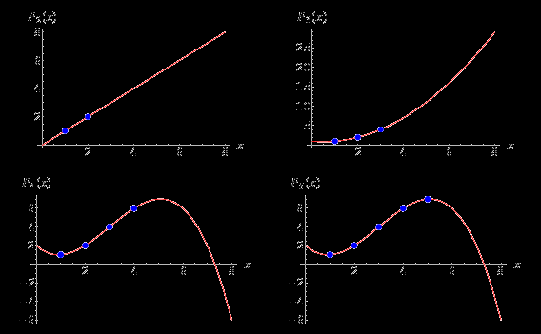
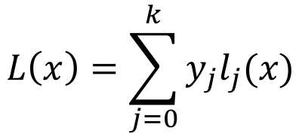
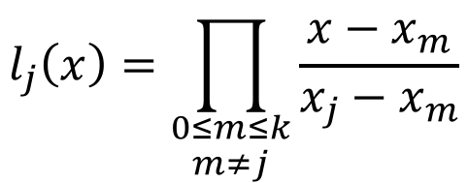
Lagrange Polynomial
$$L\left(x\right)=\sum_{j=0}^{k}{y_{j}l_{j}(x)}$$
$$l_{j}\left(x\right)=\prod_{\begin{aligned}0≤m≤k \\ m≠j\end{aligned}}{\frac{x−x_{m}}{x_{j}−x_{m}}}$$

Slide 13
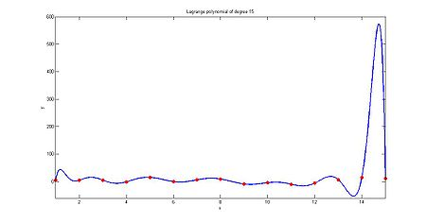
Lagrange Polynomial
$$L\left(x\right)=\sum_{j=0}^{k}{y_{j}l_{j}(x)}$$
$$l_{j}\left(x\right)=\prod_{\begin{aligned}0≤m≤k \\ m≠j\end{aligned}}{\frac{x−x_{m}}{x_{j}−x_{m}}}$$
Polynomial of order k-1 for k points of interpolation
Too flexible – Over Fitting

Slide 14
Polynomial Curve Formulations
Blending
Functions
Algebraic coefficient matrix
Geometric information
Coefficient matrix

Slide 15
Hermite

Slide 16
Cubic Bezier
Interior control points play the same role as the tangents of the Hermite formulation

Slide 17
Catmull-Rom
* End conditions are handled differently

Slide 18

Controlling Motion along
$$p=p(u)$$
Step 2. Reparameterization by arc length
u = U(s) where s is distance along the curve
Step 3. Speed control
for example, ease-in / ease-out
s = ease(t) where t is time

Slide 19
Reparameterizing by Arc Length
Analytic
Forward differencing
Supersampling
Adaptive approach
Numerically
Adaptive Gaussian

Slide 20
Reparameterizing by Arc Length - Analytic
Can’t always be solved analytically for our curves

Slide 21
Reparameterizing by Arc Length - Supersample
Calculate a bunch of points at small increments in u
Compute summed linear distances as approximation to arc length
Build table of (parametric value, arc length) pairs
Notes
Often useful to normalize total distance to 1.0
Often useful to normalize parametric value for multi-segment curve to 1.0

Slide 22
Build a table of approx. lengths
index | u | Arc Length
0 | 0.00 | 0.000
1 | 0.05 | 0.080
2 | 0.10 | 0.150
3 | 0.15 | 0.230
... | ... | ...
20 | 1.00 | 1.000

Slide 23
Adaptive Approach – How fine to sample?
Compare successive approximations and see if they agree within some tolerance
Test can fail – subdivide to predefined level, then start testing

Slide 24
Reparameterizing by Arc Length
Analytic
Forward differencing
Supersampling
Adaptive approach
Numerically
Adaptive Gaussian
Sufficient for many problems

Slide 25
Speed Control
distance
Time-distance function
Ease-in
Cubic polynomial
Sinusoidal segment
Segmented sinusoidal
Constant acceleration
General distance-time functions
time

Slide 26
Time Distance Function
S
s
s = S(t)
t

Slide 27
Ease-in/Ease-out Function
S
s
1.0
s = S(t)
0.0
0.0
1.0
t
Normalize distance and time to 1.0 to facilitate reuse

Slide 28
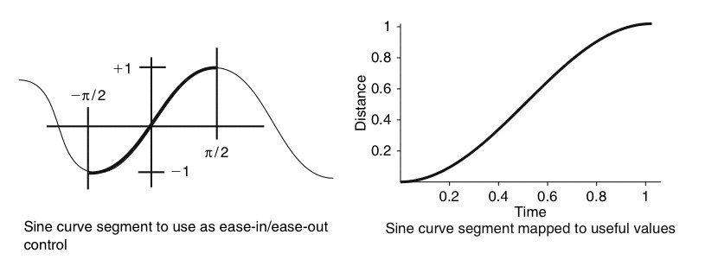
Ease-in: Sinusoidal

Slide 29
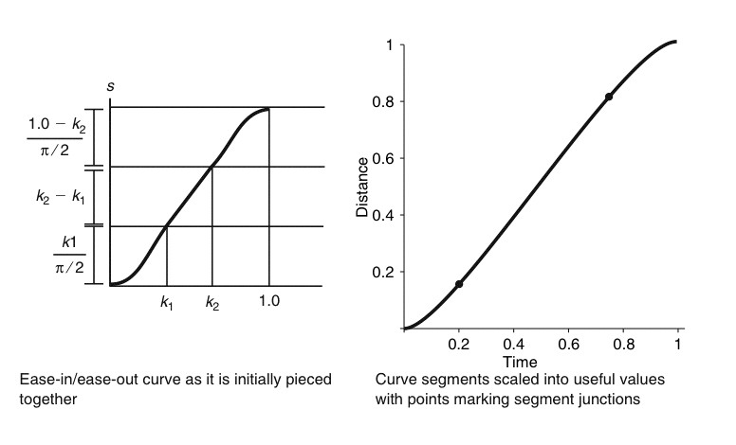
Ease-in: Piecewise Sinusoidal

Slide 30
Ease-in: Piecewise Sinusoidal
where
Provides linear (constant velocity) middle segment

Slide 31
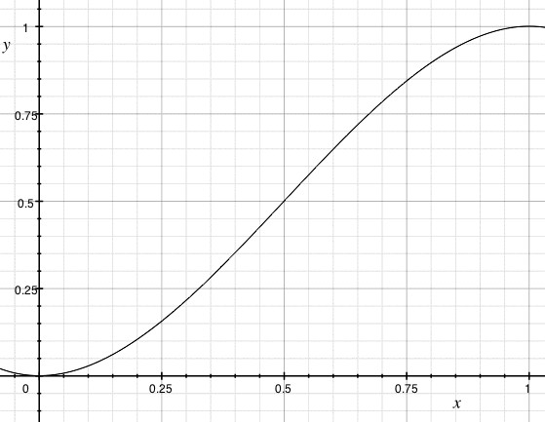
Ease-in/Ease-out: Single Cubic

Slide 32
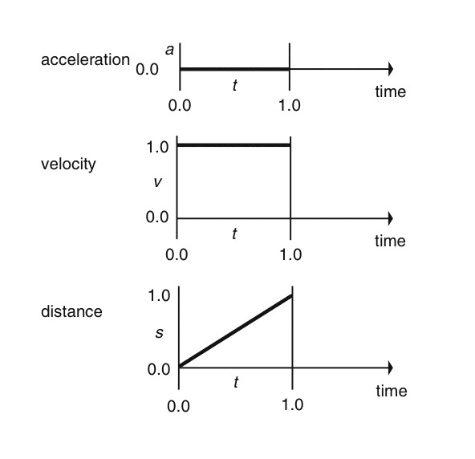
Ease-in: Constant Acceleration

Slide 33
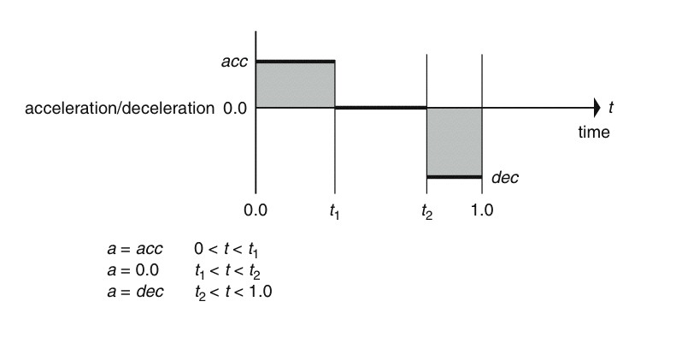
Ease-in: Constant Acceleration

Slide 34
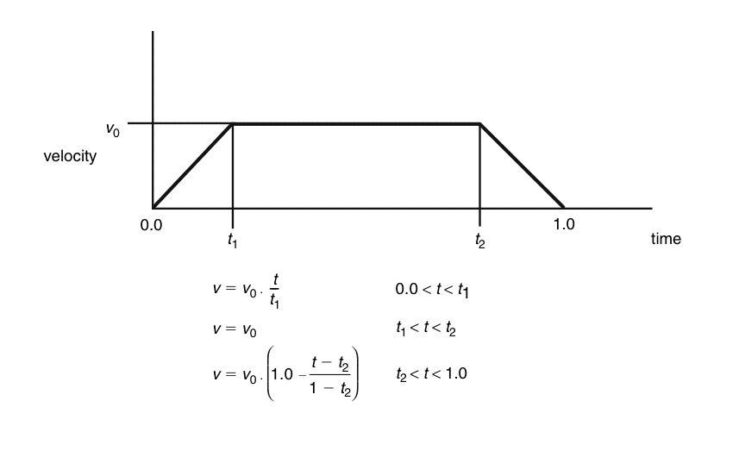
Ease-in: Constant Acceleration

Slide 35
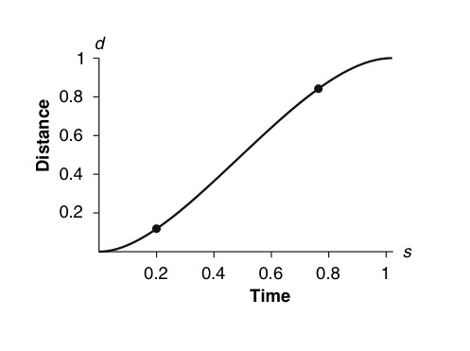
Ease-in: Constant Acceleration

Slide 36
Constant Acceleration

Slide 37


Motivation – solution steps
1. Construct a space curve that interpolates the given points with piecewise first order continuity
$$p=p(u)$$
2. Construct an arc-length-parametric-value function for the curve
$$u=u(s)$$
3. Construct time-arc-length function according to given constraints
$$s=s(t)$$
$$p=p(u(s(t)))$$

Slide 38
Arbitrary Speed Control
Animators can work in:
Distance-time space curves
Velocity-time space curves
Acceleration-time space curves
Set time-distance constraints
etc.

Slide 39
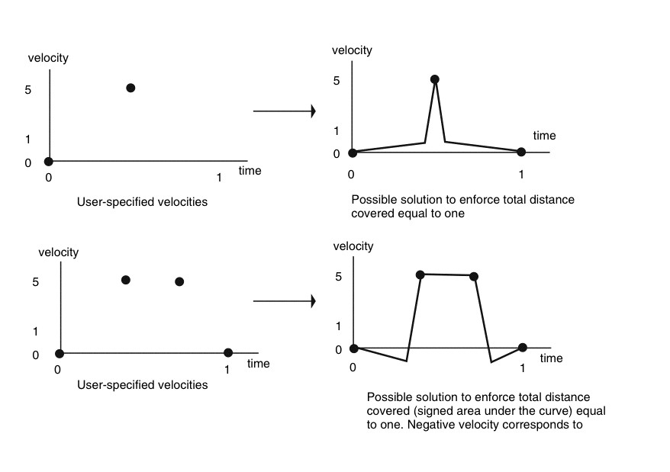
Curve fitting to velocity-time pairs

Slide 40
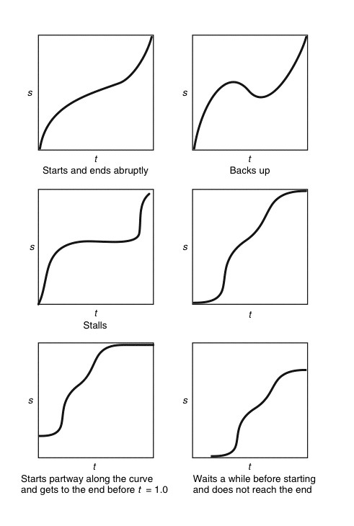
Working with time-distance curves

Slide 41
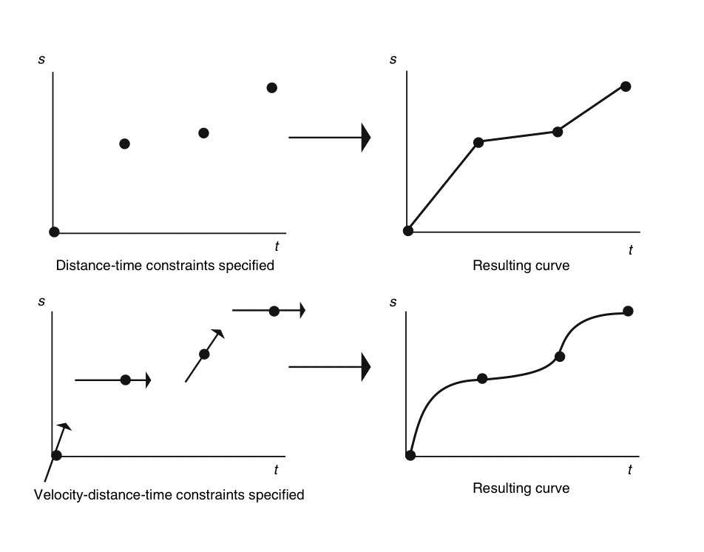
Interpolating distance-time pairs

Slide 42
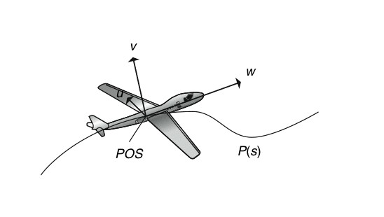
Frenet Frame – control orientation

Slide 43
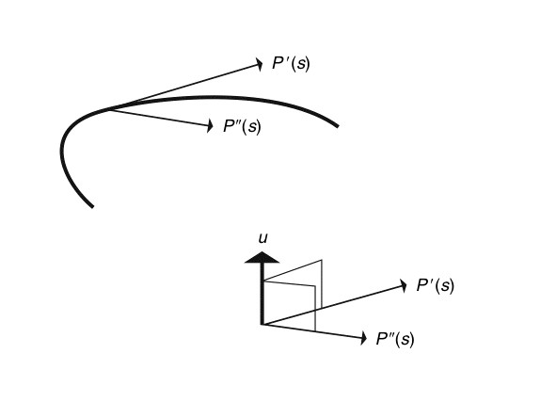
Frenet Frame – tangent & curvature vector

Slide 44

Frenet Frame – tangent & curvature vector

Slide 45
Frenet Frame – tangent & curvature vector

Slide 46
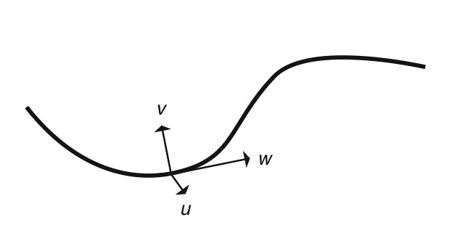
Frenet Frame – local coordinate system
Directly control orientation of object/camera
Use for direction and bank into turn, especially for ground-planar curves (e.g. roads)
v is perpendicular to w if curve is parameterized by arclength; otherwise probably not perpendicular
For general curve must
v = wxu

Slide 47
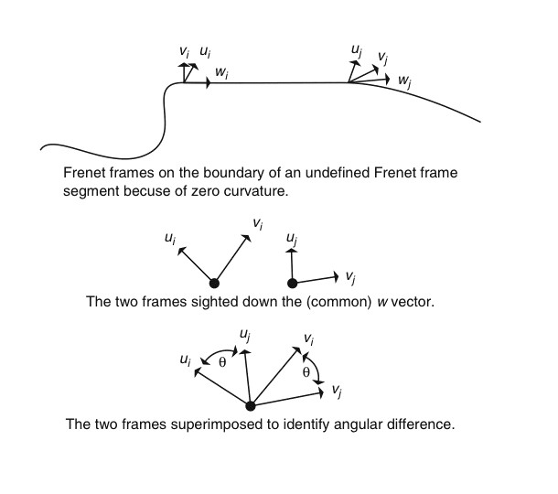
Frenet Frame - undefined

Slide 48
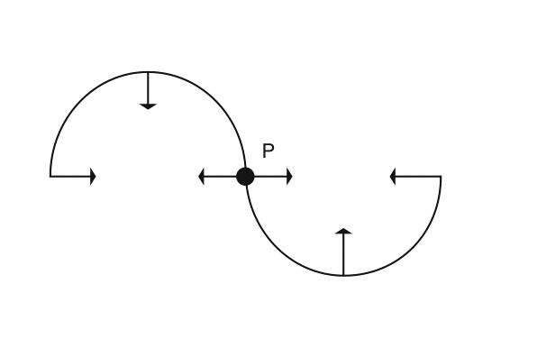
Frenet Frame - discontinuity

Slide 49
Other ways to control orientation
Use auxiliary curve to define direction or up vector
Use point P(s+ds) for direction

Slide 50
Direction & Up vector
To keep ‘head up’, use y-axis to compute over and up vectors perpendicular to direction vector
v = u x w
w
If up vector supplied, use that instead of y-axis
u=w x y-axis
Direction vector

Slide 51
Reading List:
Chapter 2.2: Orientation representation

